Slide 1
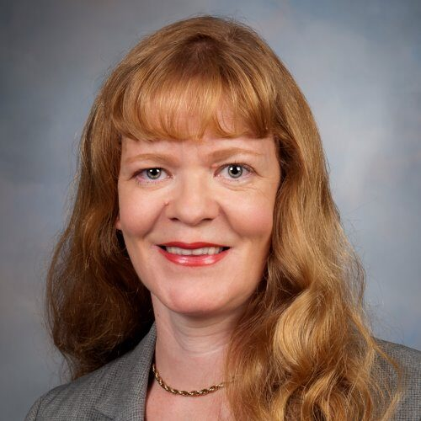
学术报告会
时间：2025年3月3日 10:30
地点：电信群楼2-410会议室
Optimizing Healthcare Outcomes through EHR: Experience in Data Sharing and Interoperability
Tiina Laatikainen
University of Eastern Finland
摘要:
In this lecture, we will explore the technical advancements in optimizing healthcare outcomes through Electronic Health Records (EHR). Focusing on key challenges and solutions in data sharing and system interoperability, we will delve into the architecture of modern EHR systems and the integration of healthcare data across different platforms. Emphasizing the role of data exchange standards, such as HL7 and FHIR, we will discuss how these technologies enable seamless information flow between healthcare providers, improving patient care and operational efficiency. The lecture will also cover emerging techniques in data management, security, and privacy, with a focus on how advancements in artificial intelligence and machine learning are being integrated into EHR systems to enhance clinical decision-making and healthcare delivery. This session aims to provide insights into the technical underpinnings of EHR systems and their potential to transform healthcare practices globally.
简介:
Tiina Laatikainen教授是芬兰著名的内科学、糖尿病、老年学和人口学研究专家。她的研究涉及糖尿病、内分泌学、身体质量指数（BMI）、肥胖、认知障碍等多个领域，尤其关注全球健康、老年学和认知衰退的关系。她的研究结合了队列研究、危险比、老年学干预等多学科方法，致力于探讨肥胖、糖尿病对健康的影响以及老年人群体中的认知干预。她的代表性工作包括全球范围内的BMI和糖尿病趋势分析，以及在芬兰开展的老年干预研究（FINGER）。她的研究为老年疾病管理和健康干预提供了重要的理论支持。她的D-index为84，共发表592篇学术论文并获得42,434的引用量。2022年，Tiina Laatikainen教授，被世卫组织任命为“非传染性疾病研究与创新技术咨询专家组”（TAG-NCD-R&I）成员，成为全球仅12位入选专家之一。这一任命展现了她在非传染性疾病领域的杰出学术成就和国际影响力。。

